Slide 1
Database Concepts
Week 1
Dr. Farshid Keivanian

Slide 2
Week 1 overview
What this module is about
What is Data?
What is Information?
Why Data is important?
Basic Concepts
How is Data stored
What is a Database?
Why Databases Are Better Than File Systems
Key Database Concepts – Tables, Records, Fields, Keys
What is Database Management System?

Slide 3
Week 1 overview
Why Use a Database?
Real-World Examples
Common Database Platforms Used in Australia
Career Paths in Data and Database Management
Key Takeaways
Discussion Questions
Relational Model Overview
Wrap-Up
Knowledge Check and Tutorial Activity
Week 1 Knowledge Check

Slide 4
Week 1 overview
WEEK 1 TUTORIAL GUIDELINE
Submission of Tutorials & Assessments
Resources

Slide 5
What this module is about
This module introduces:
What data is
How data is stored
What a database is
Why databases are important
Career paths in data

Slide 6
What this module is about
Why this matters
Today, almost everything uses data:
Banking systems
Hospitals
Online shopping
Social media
Government systems

Slide 7
What this module is about
Understanding data is the foundation of:
Programming
Cyber security
Data science
Business systems

Slide 8
What is Data?
Data is raw facts and figures.
Examples:
Name: Ali
Age: 25
Temperature: 32°C
Price: $15.50
Data by itself may not mean much.

Slide 9
What is Information?
Information is processed data that has meaning.
Example:
Data: 32, 34, 36, 38
Information: “The temperature is increasing.”
Data → Processed → Information

Slide 10
Why Data is important?
Organizations use data to:
Make decisions
Track performance
Predict trends
Improve services
Example: A supermarket uses sales data to decide what products to restock.

Slide 11
Analogy
Data is like ingredients (flour, eggs, sugar). Information is the cake you bake using those ingredients!
Australian Example: Data: 24°C, 60% humidity Information: "It’s a warm and slightly humid day in Melbourne – wear light clothing."

Slide 12
Basic Concepts
1. Data vs Information
Data = raw facts
Information = organized, meaningful data

Slide 13
Basic Concepts
2. Types of Data
Structured Data
Organized in rows and columns. Example:
ID | Name | Age
1 | Sara | 22
Used in databases.

Slide 14
Basic Concepts
Unstructured Data
Not organized in tables. Examples:
Images
Videos
Emails
Social media posts

Slide 15
Basic Concepts
3. Metadata
Metadata = data about data.
Example:
File size
Date created
Author name

Slide 16
Basic Concepts
4. Records and Fields
Field = one piece of data (e.g., Age)
Record = a full row of data (e.g., all details about one student)

Slide 17
How is Data stored
Data storage has evolved over time.
1. Paper-Based Storage (Old Method)
Filing cabinets
Paper forms
Books
Problems:
Slow
Easy to lose
Hard to search

Slide 18
How is Data stored
2. Digital Files
Data stored in:
Text files (.txt)
Excel files (.xlsx)
CSV files (.csv)
Problems:
Hard to manage large data
Risk of duplication
No strong security

Slide 19
How is Data stored
3. Database Systems (Modern Solution)
Data stored:
In structured format
In tables
Managed by software
Advantages:
Fast search
Secure
Supports many users
Reduces duplication

Slide 20
How is Data stored
Storage Devices
Hard drives
SSD
Cloud storage
Servers

Slide 21
What is a Database?
A database is an organized collection of data stored electronically.
Example: A university database stores:
Student records
Courses
Grades
Staff details

Slide 22
Why Databases Are Better Than File Systems
From Spreadsheets to Smart Databases
Traditional file systems (e.g., Excel sheets) are like paper folders ➤ Easy for small tasks, messy for large operations
Databases are like online banking apps – fast, secure, searchable, multi-user

Slide 23
Why Databases Are Better Than File Systems
Feature | File System | Database ()
Data Redundancy | High | Low
Search Speed | Slow | Fast
Multi-user Access | Hard | Easy
Security | Weak | Strong

Slide 24
Why Databases Are Better Than File Systems
Australian Analogy: Think of ATO’s tax records – you can’t manage millions of taxpayer files using Excel. Databases keep it fast, secure, and reliable.

Slide 25
Key Database Concepts – Tables, Records, Fields, Keys
Tables, Records, Fields & Keys – The Building Blocks
Table = Like a spreadsheet
Record (row) = One item (e.g., a student)
Field (column) = A characteristic (e.g., name, ID)
Primary Key = A unique ID (e.g., Student ID)

Slide 26
Key Database Concepts – Tables, Records, Fields, Keys
Analogy: A student database is like a university class list. Each student = a record Each column = name, major, email The Student ID = primary key to uniquely identify each person

Slide 27
Key Database Concepts – Tables, Records, Fields, Keys
Example:
Student ID | Name | Major
S123456 | Aria Chen | Cybersecurity

Slide 28
What is Database Management System?
(Database Management System) is software that manages databases.
Examples:
MySQL
Oracle
SQL Server
PostgreSQL

Slide 29
What is Database Management System?
allows users to:
Add data
Delete data
Update data
Search data

Slide 30
Real-World Examples of Usage
Where Do We Use Databases in Australia?
Examples:
Medicare (MyGov) – Patient info, appointments, prescriptions
MyUni ACU System – Student records, course enrollments, grades
Woolworths Rewards – Tracks customer purchases, rewards
Centrelink – Client details, payment history, benefit eligibility

Slide 31
Real-World Examples of Usage
Why It Matters: Good database systems = faster services, fewer errors, better decisions.

Slide 32
Why Use a Database?
Better organization
Faster access
Improved security
Backup and recovery
Multi-user access

Slide 33
Real-World Examples
Bank system:
Customer accounts
Transactions
Loans
Hospital system:
Patient records
Appointments
Prescriptions

Slide 34
Real-World Examples
E-commerce:
Products
Orders
Payments

Slide 35
Common Database Platforms Used in Australia
In Australia, businesses and developers use a mix of database technologies — both traditional relational databases and modern cloud-based systems. Some are especially popular:

Slide 36
Common Database Platforms Used in Australia
1. MySQL
One of the most common databases used in websites and many business applications.
It stores data in tables and uses SQL (Structured Query Language).
Especially popular for small/medium business apps and web platforms.
Reports show MySQL has very high usage on Australian websites.

Slide 37
Common Database Platforms Used in Australia
2. Microsoft SQL Server
Widely used in larger companies.
Works well with other Microsoft tools and corporate applications.
Good for business systems that need strong support and security.

Slide 38
Common Database Platforms Used in Australia
3. Oracle Database
Often used by large enterprises (e.g., banks, government, big organisations).
Very powerful and can handle huge amounts of data.

Slide 39
Common Database Platforms Used in Australia
Cloud-Based Databases Growing in Use
Many Australian companies also use databases hosted in the cloud, such as:
Amazon RDS / AWS database services
Google Cloud SQL
Snowflake and Redshift for analytics
These make it easier to scale and manage data without owning servers.

Slide 40
Common Database Platforms Used in Australia
Summary
Type | Common Examples in Australia | Why used
Relational (SQL) | MySQL, SQL Server, Oracle | Organised data, easy reporting
Cloud Databases | AWS, Google Cloud, Snowflake | Flexible, scalable, cheaper setup
Analytics Databases | PostgreSQL, Redshift | For data analysis and insights

Slide 41
Common Database Platforms Used in Australia
What This Means
Small websites and apps → often MySQL
Business/enterprise systems → often SQL Server or Oracle
Cloud-first companies → use cloud database services

Slide 42
Common Database Platforms Used in Australia
Companies pick the database based on:
How much data they have
How many users need access
Whether they want on-site servers or cloud setup

Slide 43
Career Paths in Data and Database Management
There are many careers in this field.
1. Database Administrator (DBA)
Responsible for:
Managing databases
Backup and recovery
Security
Performance tuning

Slide 44
Career Paths in Data and Database Management
2. Data Analyst
Analyzes data
Creates reports
Finds patterns
Helps decision-making

Slide 45
Career Paths in Data and Database Management
3. Data Scientist
Uses statistics and machine learning
Builds prediction models
Works with big data

Slide 46
Career Paths in Data and Database Management
4. Database Developer
Designs databases
Writes SQL queries
Creates stored procedures

Slide 47
Career Paths in Data and Database Management
5. Data Engineer
Builds data pipelines
Manages big data systems
Works with cloud databases

Slide 48
Career Paths in Data and Database Management
6. Business Intelligence (BI) Developer
Creates dashboards
Visualizes data
Supports management decisions

Slide 49
Career Paths in Data and Database Management
Analogy: If a database is a hospital, the:
DBA = technician
Analyst = doctor reading reports
Scientist = researcher
Architect or Data Engineer = engineer designing hospital layout

Slide 50
Career Paths in Data and Database Management
Skills Needed
SQL
Data modeling
Basic programming
Analytical thinking
Problem solving

Slide 51
Key Takeaways
Data = raw facts
Information = processed data
Databases store structured data
manages databases
Many career opportunities exist in data

Slide 52
Discussion Questions
Why is data important in modern businesses? (1 min)
Data helps businesses:
Make better decisions
Understand customers
Increase sales
Reduce costs
Plan for the future

Slide 53
Discussion Questions
Example: A store checks sales data to see which products sell the most. Then they order more of those products.
Without data, businesses would be guessing.

Slide 54
Discussion Questions
Why problems can happen without databases? (1 min)
Without databases:
Data can be lost
Information can be duplicated
Searching for data is slow
Mistakes happen easily
Security is weak
Reports take longer to prepare

Slide 55
Discussion Questions
Example: If a hospital stores patient data in paper files, it may take a long time to find a patient’s record in an emergency.
Databases keep data organized and easy to access.

Slide 56
Discussion Questions
What is the difference between structured and unstructured data? (1 min)
Structured data
Organized in tables (rows and columns)
Easy to search and analyze
Example: Student ID, Name, Age in a table

Slide 57
Discussion Questions
Unstructured data
Not organized in tables
Harder to analyze
Example: Emails, videos, photos, social media posts
Simple difference: Structured = organized Unstructured = not organized

Slide 58
Discussion Questions
What career interests you most in data? (1 min)
You can answer personally, but here is a sample response:
“I am most interested in becoming a Data Analyst because I like working with numbers and finding patterns. I enjoy solving problems and helping businesses make better decisions.”
There is no right or wrong answer — choose a career that matches your interests and strengths.

Slide 59
Relational Model Overview
Relational Model – Linking Tables Together
Tables are linked using keys
Avoids duplication – use foreign keys to reference data from other tables
Makes querying, updating, and managing data easier

Slide 60
Relational Model Overview
Analogy: Like a Myki card linking your name, travel history, and payment info across systems – not stored in one place, but connected.
Example (University):
Students table
Courses table
Enrollments table (link between both using Student ID and Course Code)

Slide 61
Wrap-Up
Week 1 Wrap-Up: What Have You Learned?
Quick Recap:
Data ≠ Information (raw vs processed)
Databases > file systems for large-scale, reliable storage
Understand tables, fields, records, keys
Relational model connects data meaningfully
is everywhere – from uni systems to government
Many career paths involve working with data

Slide 62
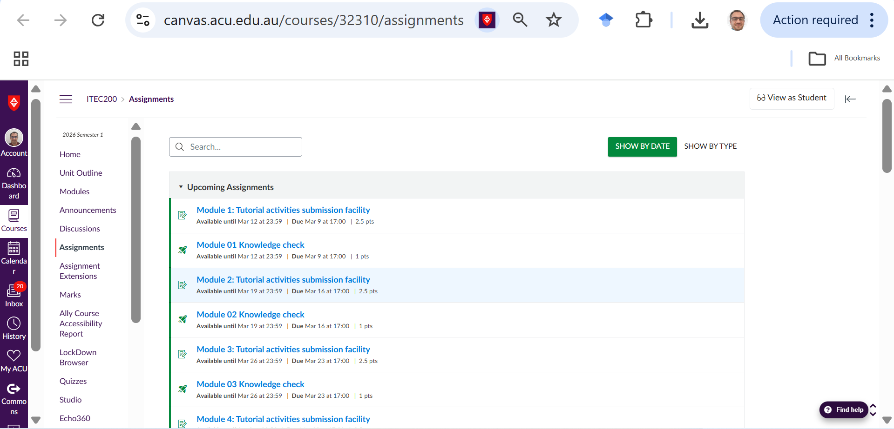
Knowledge Check and Tutorial Activity
Knowledge Check: For each week, you must compete Knowledge check and tutorial activity

Slide 63
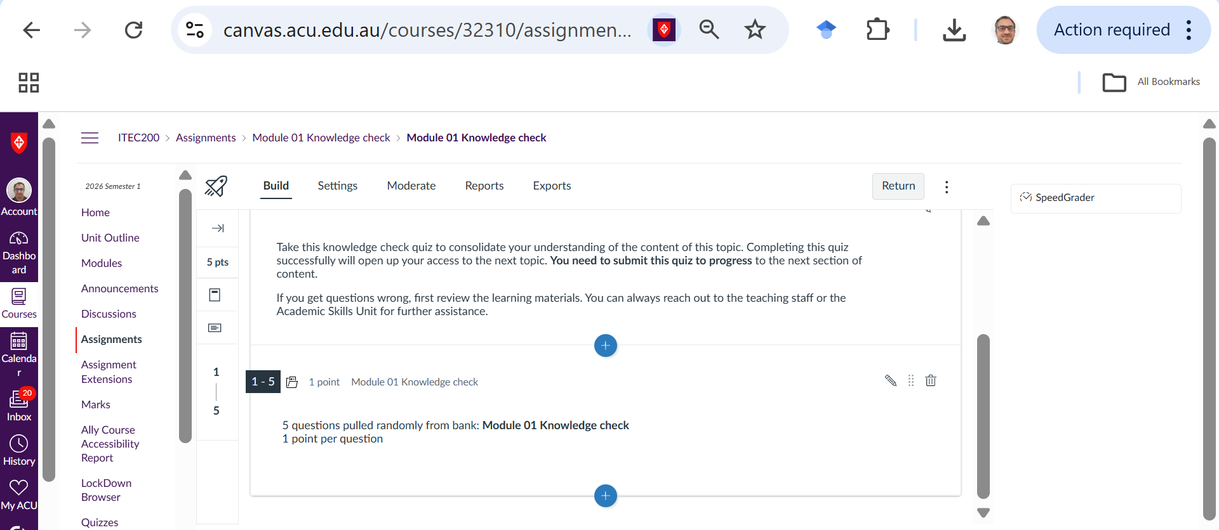
Week 1 Knowledge Check

Slide 64
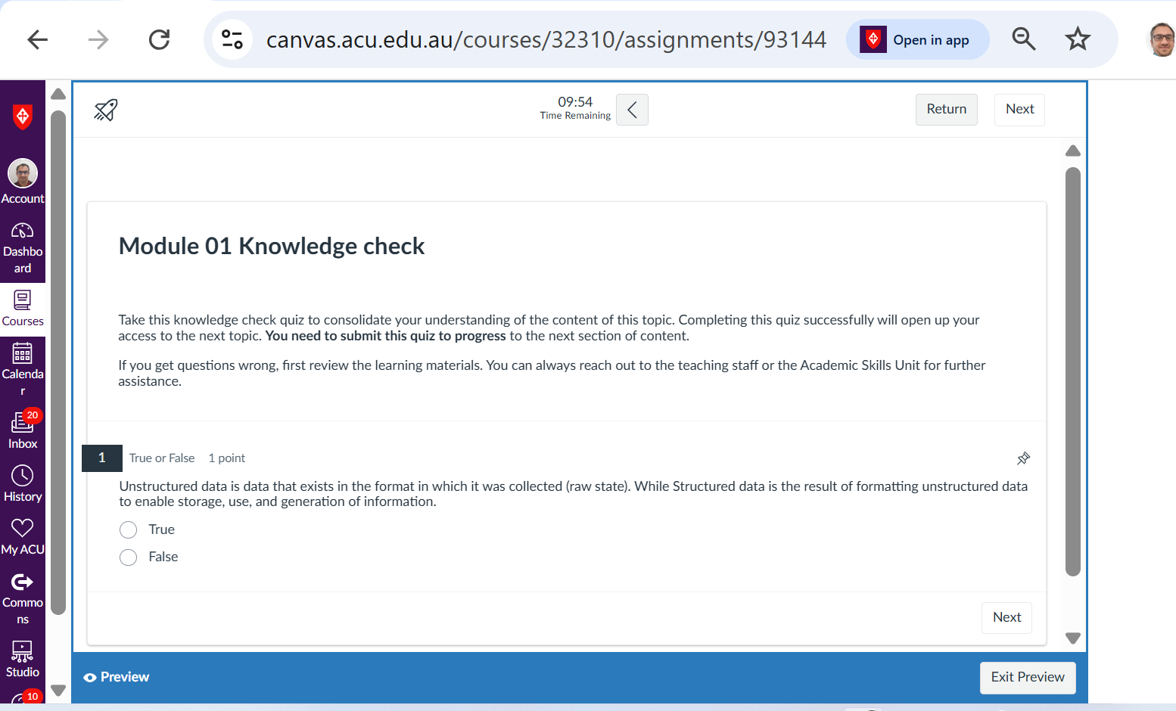
Week 1 Knowledge Check

Slide 65
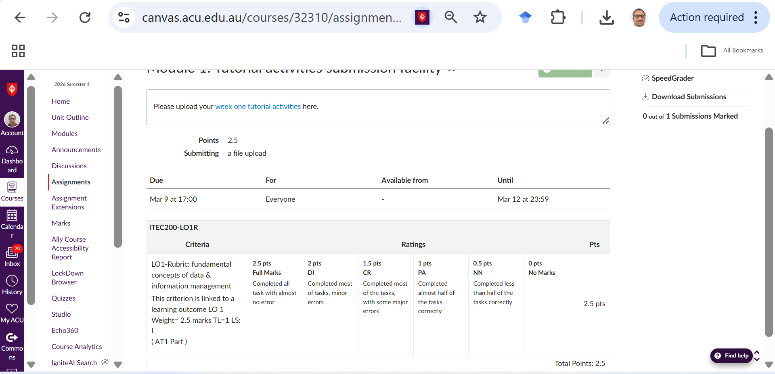
WEEK 1 TUTORIAL GUIDELINE

Slide 66
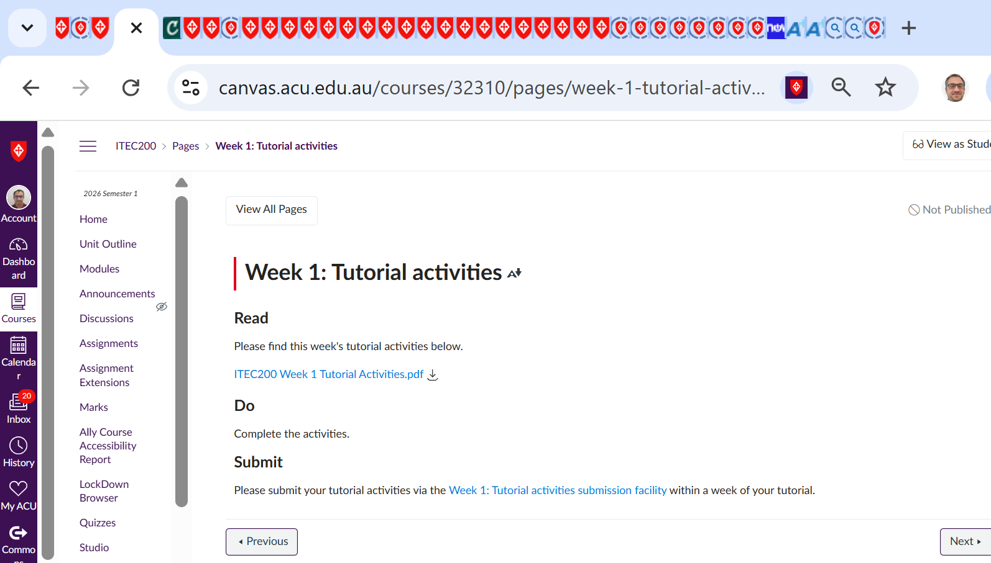
WEEK 1 TUTORIAL GUIDELINE

Slide 67
WEEK 1 TUTORIAL GUIDELINE
This part is an optional guide created to help you understand and implement the steps from the official Week 1 – Tutorial instructions. It also includes a step-by-step walkthrough for Question 1. Please ensure you follow the official instructions and assessment on Canvas when completing your tutorial and submitting your work.

Slide 68
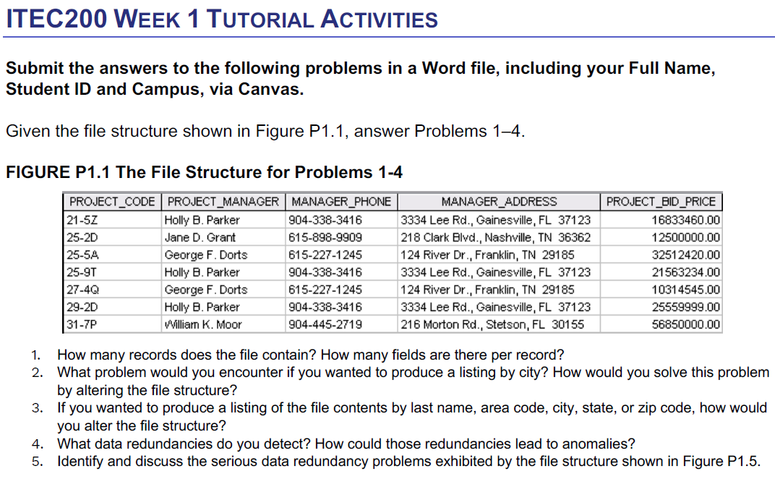
WEEK 1 TUTORIAL GUIDELINE
Instructions:
Goal: Use Figure P1.1 (first image) to answer Questions 1–4. Submit your responses in a Word document via Canvas > Module 1 > Tutorial activities submission facility. Submission Format: Include:
Full Name
Student ID
Campus
Answers to Questions 1–4 in full sentences

Slide 69
WEEK 1 TUTORIAL GUIDELINE
Step-by-Step: Do this
1. Understand the file structure (Figure P1.1)
Open the first image. Each row is a record, and each column is a field (PROJECT_CODE, PROJECT_MANAGER, etc.).

Slide 70
WEEK 1 TUTORIAL GUIDELINE
2. Work on Question 1 only:
Q1. How many records does the file contain? How many fields are there per record?

Slide 71
WEEK 1 TUTORIAL GUIDELINE
The file contains 7 records. Each row from the table represents one project record.
There are 5 fields per record:
PROJECT_CODE
PROJECT_MANAGER
MANAGER_PHONE
MANAGER_ADDRESS
PROJECT_BID_PRICE
You can count the number of rows (excluding headers) for total records and the number of columns for total fields.

Slide 72
WEEK 1 TUTORIAL GUIDELINE
2. Problem when listing by city & how to fix it (3 min)
Problem: City is stored inside the MANAGER_ADDRESS field together with street, state, and ZIP code. Because all address parts are combined in one field, the database cannot easily sort or filter by city.

Slide 73
WEEK 1 TUTORIAL GUIDELINE
Solution: Break MANAGER_ADDRESS into separate fields:
STREET
CITY
STATE
ZIP_CODE
This makes it easy to sort or list records by city.

Slide 74
WEEK 1 TUTORIAL GUIDELINE
3. If you wanted to produce a listing of the file contents by last name, area code, city, state, or zip code, how wouldyou alter the file structure?

Slide 75
WEEK 1 TUTORIAL GUIDELINE
Changes needed to list by last name, area code, city, state, or zip code
Currently:
Manager name is stored as one field (first and last name together).
Phone number is stored as one field (including area code).
Address is stored as one field.

Slide 76
WEEK 1 TUTORIAL GUIDELINE
To allow sorting/listing by those items, split fields into smaller parts:
Split PROJECT_MANAGER into:
FIRST_NAME
LAST_NAME
Split MANAGER_PHONE into:
AREA_CODE
PHONE_NUMBER

Slide 77
WEEK 1 TUTORIAL GUIDELINE
Split MANAGER_ADDRESS into:
STREET
CITY
STATE
ZIP_CODE
This structure makes sorting and searching much easier.

Slide 78
WEEK 1 TUTORIAL GUIDELINE
4. What data redundancies do you detect? How could those redundancies lead to anomalies?
4. Data redundancies and possible anomalies
Redundancies found:
Some managers appear more than once (e.g., Holly B. Parker, George F. Dorts).

Slide 79
WEEK 1 TUTORIAL GUIDELINE
4. What data redundancies do you detect? How could those redundancies lead to anomalies?
Their phone numbers and addresses are repeated in multiple records.

Slide 80
WEEK 1 TUTORIAL GUIDELINE
Problems caused (anomalies):
Update anomaly: If a manager changes phone number, you must update it in several records. If you miss one, data becomes inconsistent.

Slide 81
WEEK 1 TUTORIAL GUIDELINE
Insertion anomaly: You cannot add a new manager unless they are assigned to a project.
Deletion anomaly: If you delete the last project of a manager, you lose all information about that manager.

Slide 82
WEEK 1 TUTORIAL GUIDELINE
5. Serious data redundancy problems
The main problem is that manager information is stored repeatedly for every project.
This means:
Manager data depends on the manager, not on the project.
But it is stored inside the project record.

Slide 83
WEEK 1 TUTORIAL GUIDELINE
This creates:
Repeated storage of the same data
High risk of inconsistent data
Wasted storage space
Data anomalies (update, insert, delete problems)

Slide 84
WEEK 1 TUTORIAL GUIDELINE
Better structure: Create two separate tables:
PROJECT table
PROJECT_CODE
PROJECT_BID_PRICE
MANAGER_ID

Slide 85
WEEK 1 TUTORIAL GUIDELINE
2. MANAGER table
MANAGER_ID
FIRST_NAME
LAST_NAME
AREA_CODE
PHONE_NUMBER
STREET
CITY
STATE
ZIP_CODE
This removes redundancy and improves data integrity.

Slide 86
WEEK 1 TUTORIAL GUIDELINE
What to AVOID:
Don’t do this | Instead, do this
Don’t submit screenshots as answers | Write clear text answers in Word
Don’t leave questions blank | Attempt all required questions
Don’t copy exact wording without thinking | Use your own understanding
Don’t upload after due date | Submit early to avoid technical issues
Don’t email the file | Submit only via Canvas

Slide 87
Submission of Tutorials & Assessments
These guidelines are designed to support your learning and help you apply necessary techniques effectively. Please do the remaining problems and follow the instructions based on Canvas. If you have any questions, feel free to ask—I’m happy to help!

Slide 88
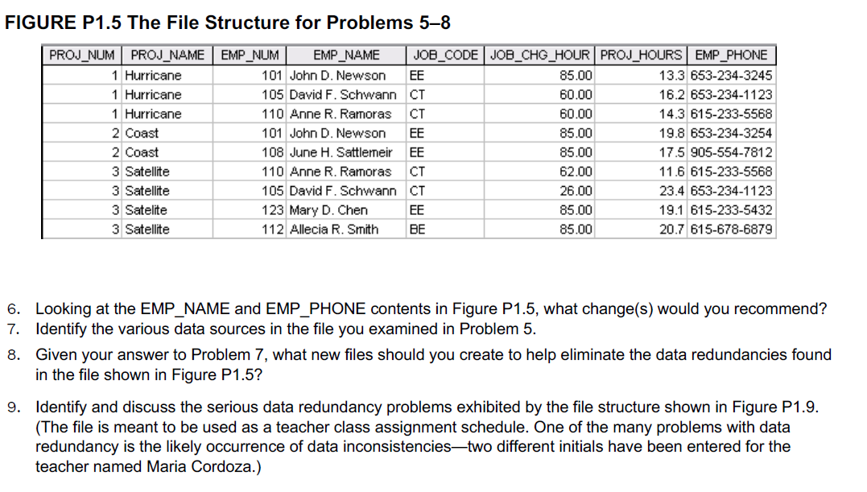
Submission of Tutorials & Assessments

Slide 89
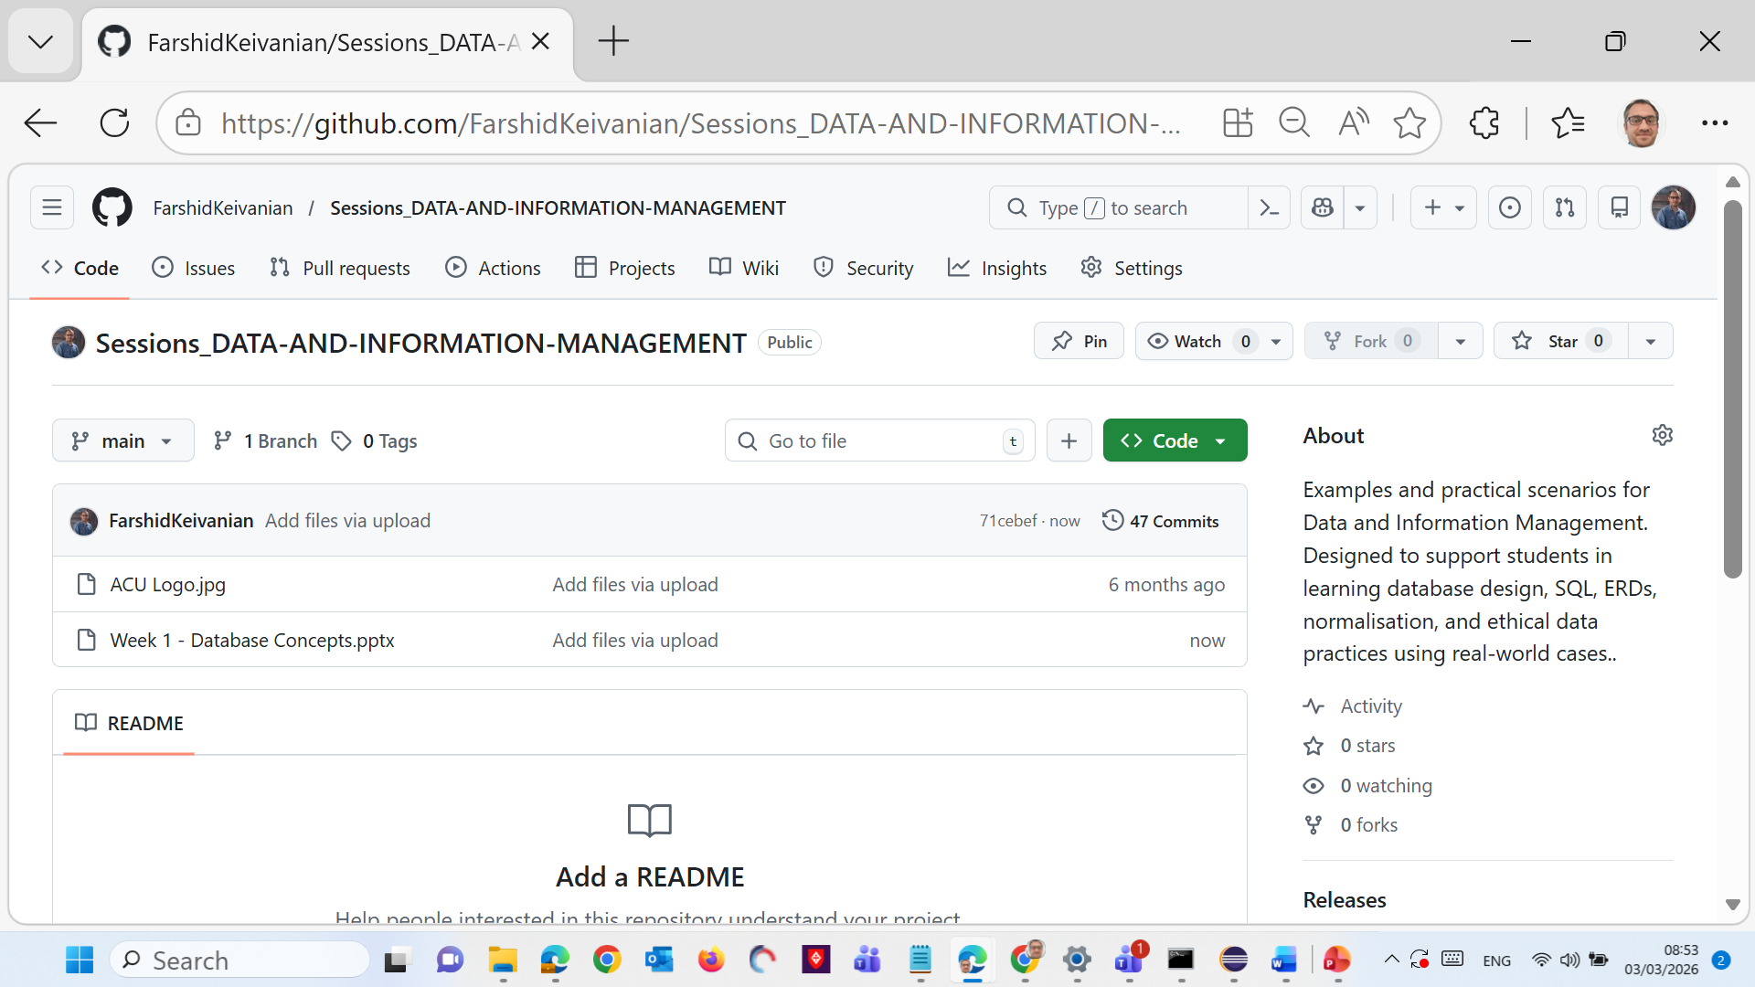
Resources
https://github.com/FarshidKeivanian
https://github.com/FarshidKeivanian/Sessions_DATA-AND-INFORMATION-MANAGEMENT

Slide 90

Let’s Answer Your Questions
Live during class – Ask directly during sessions.
Canvas Inbox – For structured academic queries.
Email – For formal communications or attachments.
Canvas Discussion Forum – Everyone can see and learn from your question.

Slide 91

Thank You
Happy Learning and Bright Futures Ahead!
Stay Connected: linkedin.com/in/farshid-keivanian github.com/FarshidKeivanian
Education is the most powerful weapon you can use to change the world. — Nelson Mandela

